Slide 1

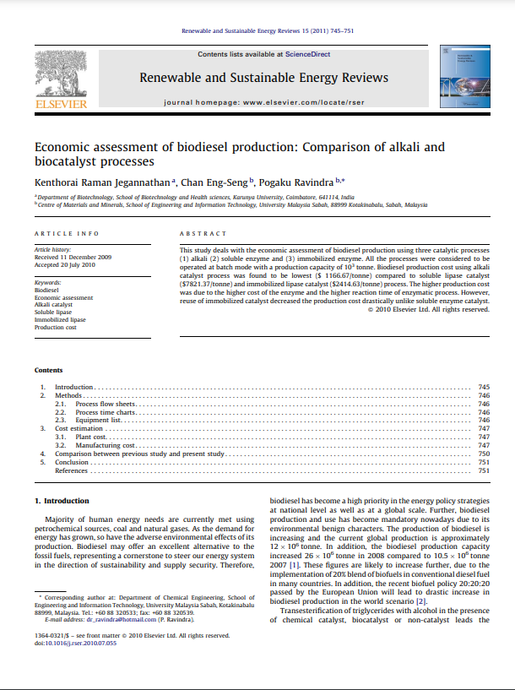

ECONOMIC ASSESSMENT OF BIODIESEL PRODUCTION : COMPARISON OF ALKALI AND BIOCATALYST PROCESS
DATE: 06/09/23
Presented by: Arushi Gupta
210107013
1

Slide 2

TABLE OF CONTENT
1 ) INTRODUCTION
Background
Literature gaps and comparisons
Objectives
2 ) MATERIALS REQUIRED
3 ) METHODS
4 ) SCHEMATIC DIAGRAMS
5 ) PROCESSES
6 ) RESULTS AND DISCUSSIONS
7 ) CONCLUSIONS AND SUMMARY
8 ) FUTURE WORK
9 ) REFERENCES
2

Slide 3

BACKGROUND
Rising energy demand leads to environmental concerns from fossil fuel use.
Biodiesel is vital for eco-friendly, sustainable energy policies globally.
Global biodiesel production is growing due to biofuel blending mandates.
The study compares three biodiesel production processes for cost-effectiveness.
Enzymatic lipase-based transesterification offers eco-friendly benefits but faces cost and reuse challenges.
3

Slide 4
LITERATURE COMPARISON AND GAPS
COMPARISON | GAPS
The study notes that previous economic assessments mainly focused on chemical catalytic processes. Sakai et al. reported a manufacturing cost of $641/tonne for biodiesel production using a KOH catalyst batch process, which is significantly lower than the costs associated with biological catalysts in the current study. | Comparative Feedstock Studies: Comparative assessments of biodiesel production from different feedstocks are lacking.
The study reported a manufacturing cost of $1167/tonne for biodiesel production from palm oil using an alkali catalyst batch process. This cost was higher than some previous studies on alkali catalyst processes | Optimizing Immobilized Catalyst Reuse: Research should explore maximizing the reuse potential of immobilized catalysts for cost efficiency.
The plant cost for biodiesel production using immobilized enzyme was 57.18% higher than the alkali catalyst process and slightly higher (0.40%) than the soluble enzyme catalyst process. | Feedstock Price Variability: The impact of fluctuating feedstock prices on biodiesel economics requires further investigation
The study suggested that with advancements in white biotechnology and enzyme technology, the cost of lipase enzymes is expected to decrease in the future, potentially making enzymatic biodiesel production more competitive. | Environmental Impact Assessment: Research should address the environmental sustainability of different biodiesel production processes through life cycle analysis.
4

Slide 5

OBJECTIVE
Compare Biodiesel Production Methods: Evaluate economic feasibility of alkali, soluble enzyme, and immobilized enzyme biodiesel processes.
Analyze Production Costs: Determine and analyze costs for each method, considering raw materials, equipment, and labor.
Assess Cost Variations: Identify reasons for cost differences, especially enzyme expenses and reaction times.
5

Slide 6

MATERIALS REQUIRED
Palm Oil: Primary feedstock for biodiesel production.
Methanol: Alcohol used in the transesterification process.
Sodium Hydroxide (NaOH): Strong catalyst for converting triglycerides to biodiesel.
HCl (Hydrochloric Acid): Used for glycerin byproduct treatment.
Glycerin: Byproduct of transesterification, requires treatment or disposal.
6

Slide 7
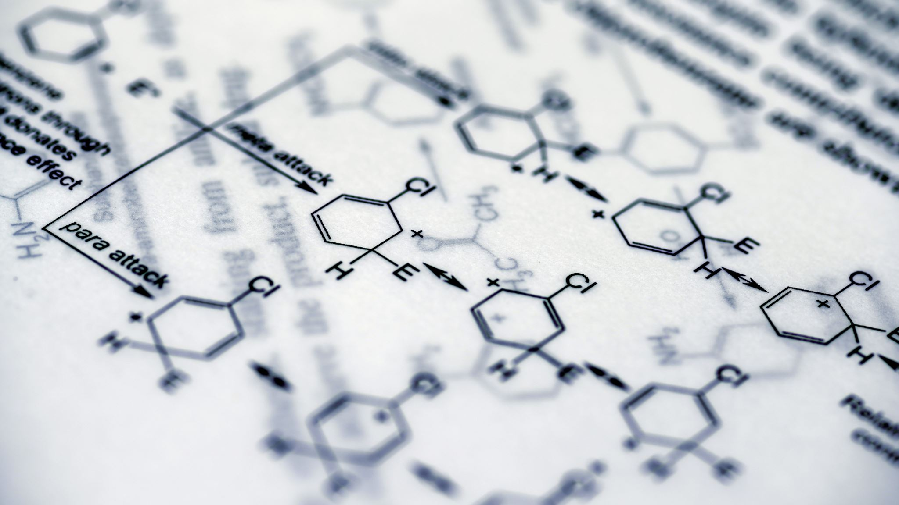
METHODS
Process Selection: Choose the specific biodiesel production process(es) to be assessed. In this study, three processes were selected: alkali catalyst, soluble enzyme catalyst, and immobilized enzyme catalyst.
Production Capacity: Determine the production capacity for the assessment. In this study, a capacity of 1000 metric tonnes of biodiesel was chosen.
Cost Estimation: Estimate both variable and fixed costs associated with biodiesel production. Variable costs are those that change with production volume, while fixed costs remain constant.
Process Description: Create process flow sheets for each selected biodiesel production process. Describe each step of the production process, including the transesterification reaction and management of byproducts.
7

Slide 8

METHODS
Production Timeline: Develop time charts that outline the duration of each step in the biodiesel production process for each chosen process. Determine the batch cycle time and overall production timeline.
Equipment Specification: Compile a list of equipment required for each process, specifying the equipment's specifications, such as size, capacity, and functionality.
Plant Cost Estimation: Estimate the total plant cost for each process. This should include the costs associated with procuring or fabricating necessary equipment, infrastructure, and facilities.
Manufacturing Cost Estimation: Calculate the manufacturing costs for each process based on unit prices of raw materials, energy, labor, and other factors. Consider depreciation, repair, interest and tax costs
8

Slide 9
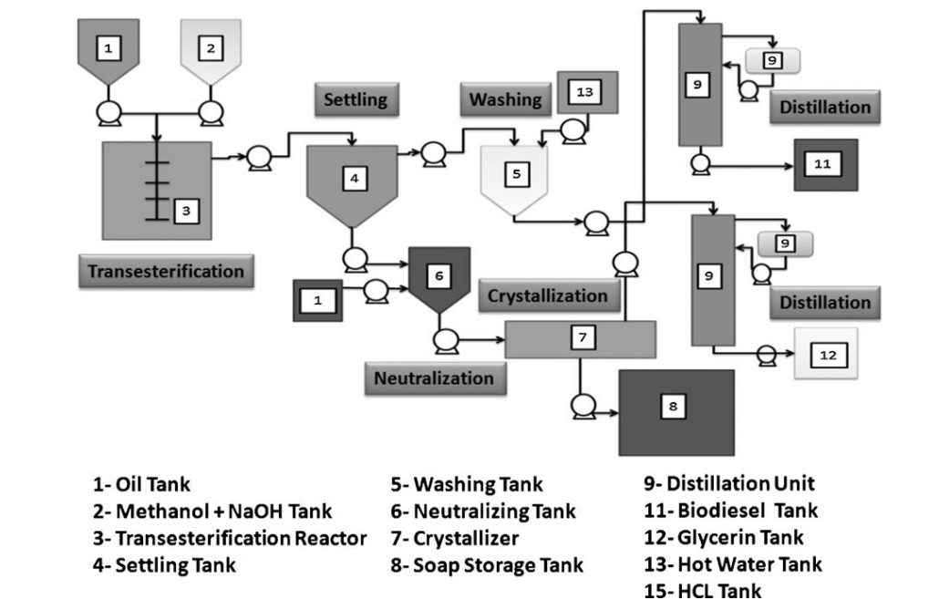
SCHEMATIC DIAGRAM Biodiesel production plant using alkali catalyst
9

Slide 10
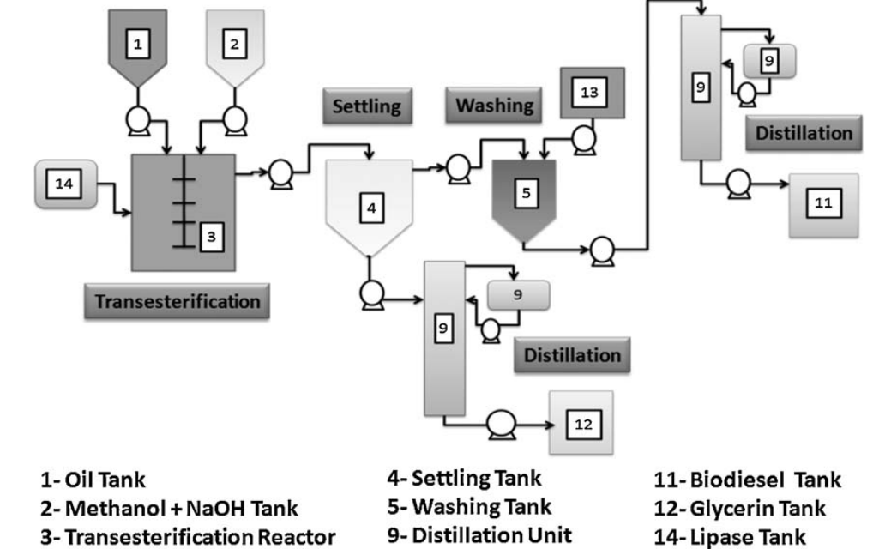
SCHEMATIC DIAGRAM biodiesel production plant using soluble lipase catalyst
10

Slide 11
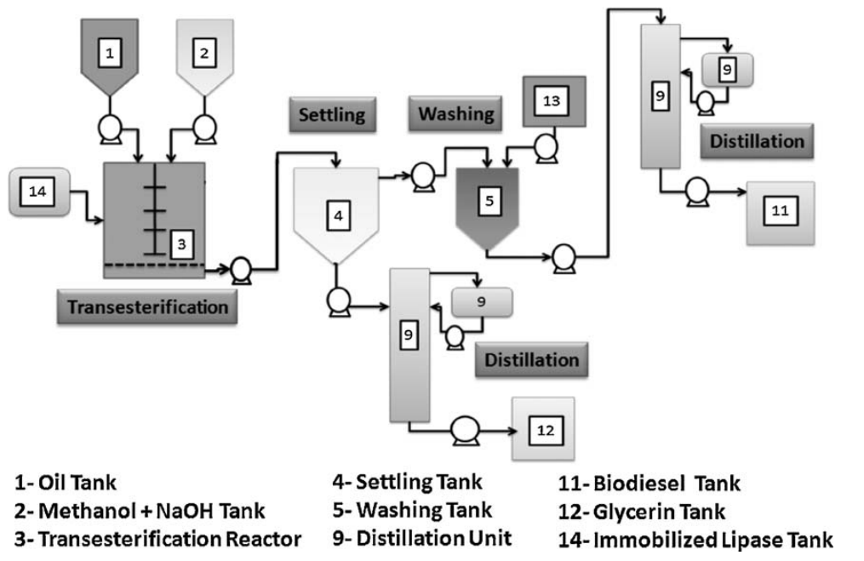
SCHEMATIC DIAGRAM biodiesel production plant using immobilized lipase catalyst
11

Slide 12
PROCESSES
Comparison of Biodiesel Production Processes: The research compares three biodiesel production processes - alkali catalyst, soluble enzyme catalyst, and immobilized enzyme catalyst - with a focus on economic assessments.
Cost Analysis: The study evaluates the costs involved in each production process, including equipment costs, plant investment, and manufacturing costs, highlighting that alkali catalyst production is generally more cost-effective.
Significance of Enzymatic Biodiesel Production: The research underscores the potential advantages of enzymatic transesterification for biodiesel production, despite higher costs, and suggests that further developments in enzymatic processes may enhance competitiveness in the future.
12

Slide 13
RESULTS AND DISCUSSIONS
Production Cost: Alkali catalyst was the cheapest at $1166.67/tonne, while soluble enzyme catalyst was the most expensive at $7821.37/tonne.
Process Time: Alkali catalyst had a shorter batch cycle time (16 hours) compared to both biocatalyst processes (83 hours).
13

Slide 14
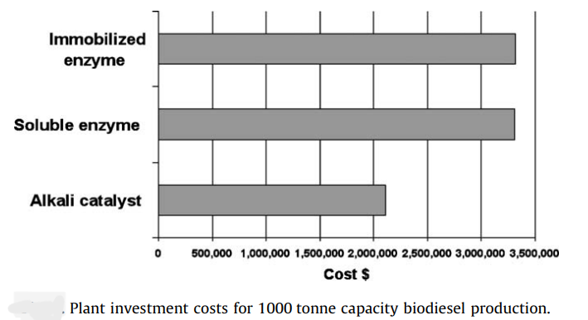
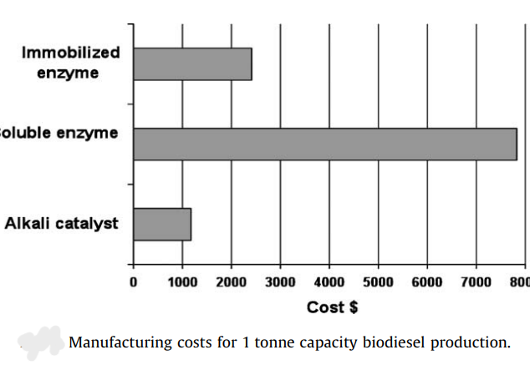
RESULTS AND DISCUSSIONS
Plant Costs: Immobilized enzyme catalyst had a 57.18% higher plant cost than alkali catalyst and a 0.40% higher cost than soluble enzyme catalyst due to longer process times.
Manufacturing Costs: Immobilized enzyme catalyst was 206.96% more expensive than alkali catalyst and 323.9% cheaper than soluble enzyme catalyst.
14

Slide 15
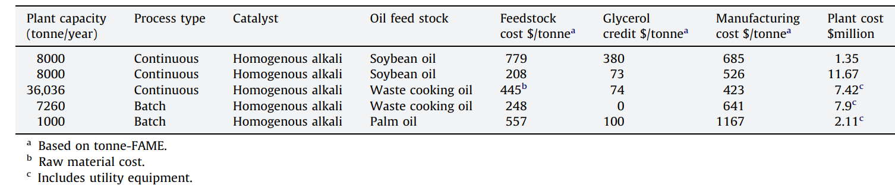
RESULTS AND DISCUSSIONS
Cost Comparison: Alkali catalyst was the most cost-effective, consistent with prior research favoring chemical catalytic processes.
Enzyme Cost: High lipase cost significantly impacted biocatalyst process economics; reducing enzyme costs could improve biocatalyst viability.
Reusability: Immobilized lipase's reusability reduced costs, making it more economically attractive than soluble enzyme catalysts.
Future Prospects: Biocatalyst-based processes could become more competitive if enzyme costs decrease and technology advances further.
15

Slide 16
CONCLUSION AND SUMMARY
Biodiesel production costs: Alkali catalyst process had the lowest cost at $1166.67/tonne, while soluble enzyme catalyst was the highest at $7821.37/tonne due to expensive enzymes and longer reaction times. Immobilized enzyme catalyst fell in between at $2414.63/tonne.
Comparison: Previous studies focused on chemical catalyst processes like KOH, reporting lower costs than biological catalysts.
Plant costs: Immobilized enzyme catalyst process had a 57.18% higher plant cost than alkali catalyst and 0.40% higher than soluble enzyme catalyst due to longer process times.
Manufacturing costs: Immobilized enzyme catalyst process cost 206.96% more than alkali catalyst but 323.9% less than soluble enzyme catalyst, mainly due to enzyme reusability.
Future potential: Advancements in white biotechnology may reduce enzyme costs, making enzymatic biodiesel production more competitive.
16

Slide 17
FUTURE WORK
Explore
Enzyme Cost Reduction: Explore cost-saving strategies in lipase enzyme production.
Evaluate
Life Cycle Assessment (LCA): Evaluate the environmental impact of enzymatic biodiesel production.
Market
Market Analysis: Analyze biodiesel market trends and demand.
Investigate
Alternative Feedstocks: Investigate the use of non-traditional feedstocks.
Foster
Collaborative Research: Foster partnerships for research and development.
Raise
Education and Outreach: Raise awareness and understanding of enzymatic biodiesel production.
17

Slide 18
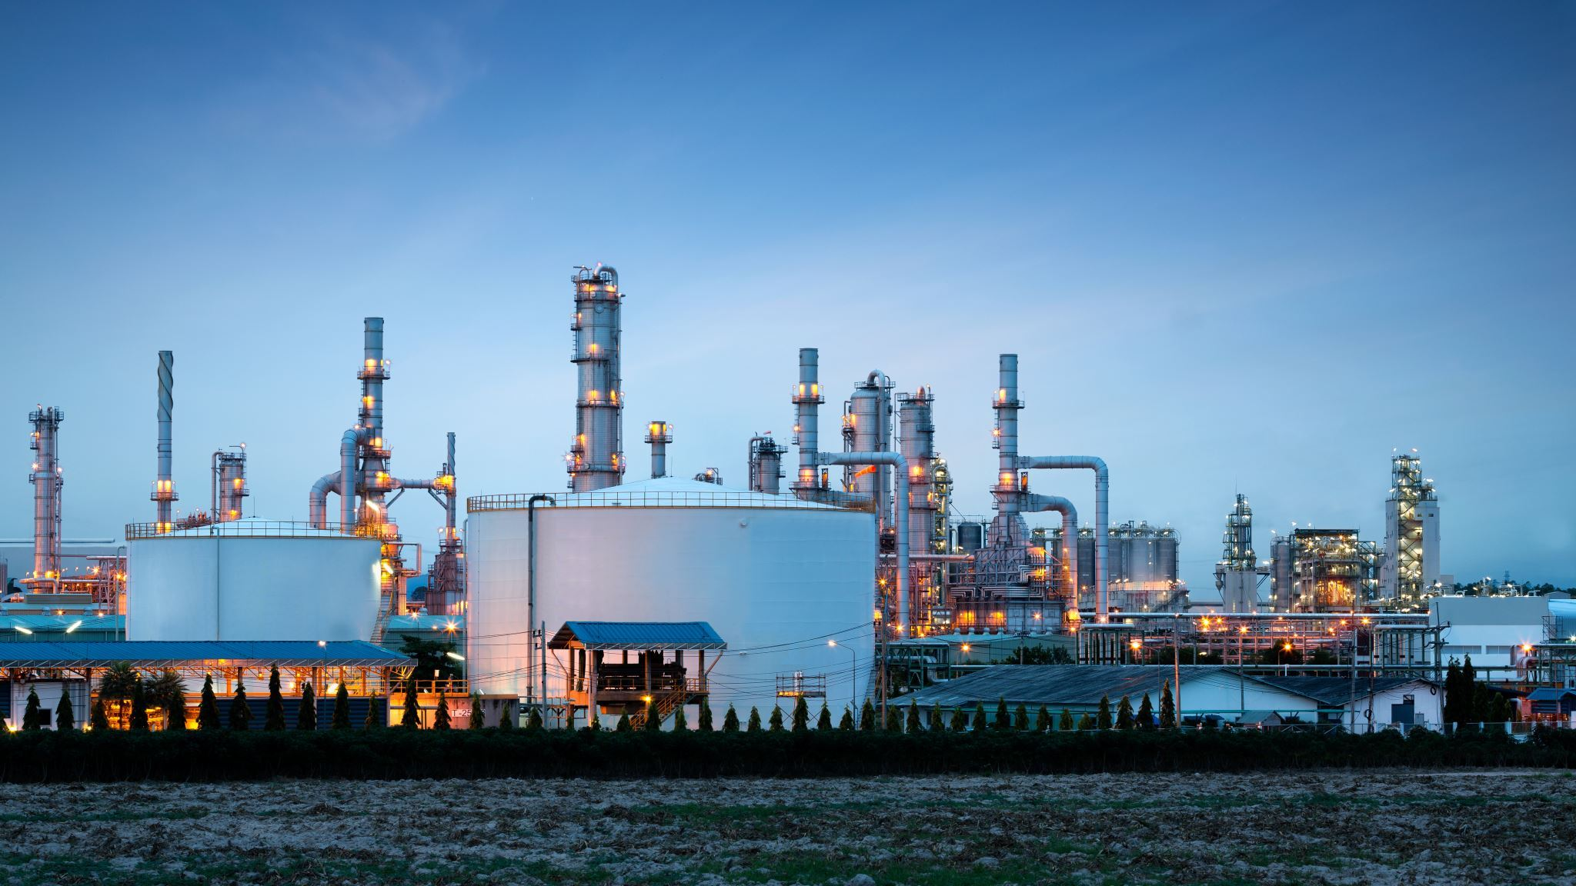
REFERENCES
Sakai T, Kawashima A, Koshikawa T. Economic assessment of batch biodiesel production processes using homogeneous and heterogeneous alkali catalysts. Bioresour Technol 2009;100:3268–76.
Jegannathan KR, Leong JY, Chan ES, Ravindra P. Designing an immobilized lipase enzyme for biodiesel production. J Renew Sust energy 2010;1:063101.
Van Kasteren JMN, Nisworo AP. A process model to estimate the cost of industrial scale biodiesel production from waste cooking oil by supercritical transesterification. Resour Conserv Recyc 2007;50:442–58.
Marchetti JM, Errazu AF. Technoeconomic study of supercritical biodiesel production plant. Energy Convers Manage 2008;49:2160–4.
Al-zuhair S. Production of biodiesel: possibilities and challenges. Biofeedback Bioprod Bioref 2007;1:57–66.
18

Slide 19

19

